Slide 1
W2 #OSG Community Topics Mapping Workshop
Select the best topics for the Community and prepare specific course of action for each one

Slide 2
Topics Mapping Workshop Example of workshop results
💗LIKED : The topics we like the most
Topic | Actions
Topic A | Share about an article or watch a video together for next session on May 22nd Organize an meetup with other people for June 15th
Topic B | Create a chat room with Alice, Bob, Charlie, Dick (who voted for this topic
Topic C | Organize a brainstorm on a likeable activity or format on this topic. If no result or too difficult to organize, leave the topic away for the moment.
Topic D | Find external guests to share about the topic for a presentation in 2 months. Find interesting content and tutorials and share in the Community Wall.
Topics E, F, G, H | Leave it away for the moment
Topic I | Officially out of scope of the Community
TOPIC G
💗
TOPIC H
💗
TOPIC B
💗 🛠️
TOPIC D
💗 🏠
🛠️SKILLED : The topics in which we are the most skilled
🏠VALUABLE : The topics with the most business impact
TOPIC A
💗 🏠 🛠️
TOPIC C
🛠️ 🏠
TOPIC E
🛠️
TOPIC F 🏠
TOPIC I

Slide 3
Topics mapping Workshop Workshop step by step
💗LIKED : The topics we like the most
TOPIC G
💗
TOPIC H
💗
TOPIC B
💗 🛠️
TOPIC D
💗 🏠
🛠️SKILLED : The topics in which we are the most skilled
🏠VALUABLE : The topics with the most business impact
TOPIC A
💗 🏠 🛠️
TOPIC E
🛠️
TOPIC C
🛠️ 🏠
TOPIC F 🏠
TOPIC I
 | 1 Introduction | 2 Example result | 3 Rules & Mindset | 4 List topics | 5 Vote | 6 (Optional) Display | 7 Commit
Suggested timebox | 5 minutes | 5 minutes | 2 minutes | 10 minutes | 5 minutes | 20 minutes | 15 minutes
Action | Explain what motivates the workshop : Find the topics that really fit the Community Consider members tastes, skills and value Address the topics according to reality, not wishes | Show expected results of the workshop (previous slide) Show how it will be used (next slide) | Remind the rules & mindset : Rule : Do not confuse topic with format. Mindset : Accept that others may have tastes, skills, and perception of value that are different than yours Mindset : Community first focuses on topics that interest the most members, other topics can be left to self organization. Mindset : Accept to choose and to let go, in order to focus | Everyone lists 1 to 3 topics that they would want to see or share in the Community. If topics are really close to each other, merge the tickets into one. | Dot-vote to identify the top 20% most liked topics. Mark these topics as LIKED. Dot-vote on the top 20% of topics for which members are most proficient (or can teach others). Mark these topics as SKILLED. Dot-vote on the top 20% of topics that are considered the most valuable for business. Mark these topics as VALUABLE. Dot-voting : https://en.wikipedia.org/wiki/Dot-voting | (Optional) Display the topics on the Venn Diagram (Optional) If votes do not lead to interesting results (nothing in common zones) : Split the Community into consistent groups (for the moment) instead of trying to maintain a fake or low common interest. | Starting the topics that are the most marked, decide and commit on actions for next session or time period. (Optional and recommended) Members who voted liked for topics are put in charge of following-up the actions
Only after a certain date, event

Slide 4
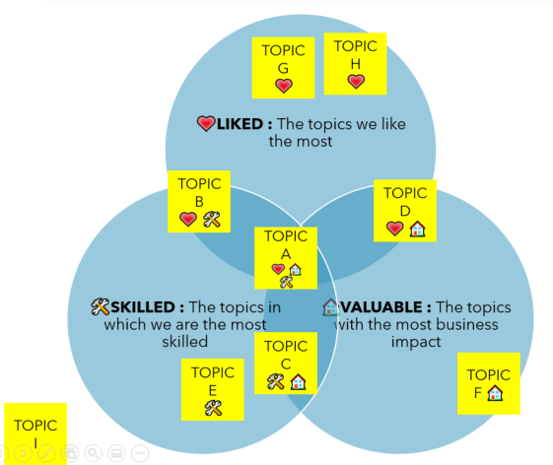
Topics mapping Workshop Workshop step by step (illustrated)
TOPIC A
TOPIC A
💗
TOPIC A
💗 🛠️
TOPIC A
💗 🛠️ 🏠
Topic | Actions
Topic A | Share about an article or watch a video together for next session on May 22nd Organize an meetup with other people for June 15th
Topic B | Create a chat room with Alice, Bob, Charlie, Dick (who voted for this topic
Topic C | Organize a brainstorm on a likeable activity or format on this topic. If no result or too difficult to organize, leave the topic away for the moment.
Topic D | Find external guests to share about the topic for a presentation in 2 months. Find interesting content and tutorials and share in the Community Wall.
Topics E, F, G, H | Leave it away for the moment
Topic I | Officially out of scope of the Community
TOPIC B
TOPIC B
💗
TOPIC B
💗 🛠️
TOPIC B
💗 🛠️
TOPIC A
💗 🛠️ 🏠
TOPIC C
TOPIC C
TOPIC C 🛠️
TOPIC C
🛠️ 🏠
TOPIC D
TOPIC D
💗
TOPIC D
💗
TOPIC D
💗 🏠
TOPIC B
💗 🛠️
TOPIC E
TOPIC E
TOPIC E 🛠️
TOPIC E 🛠️
TOPIC C
🛠️ 🏠
TOPIC F
TOPIC F
TOPIC F
TOPIC F
🏠
TOPIC D
💗 🏠
TOPIC G
TOPIC G
💗
TOPIC G
💗
TOPIC G
💗
TOPIC H
TOPIC H
💗
TOPIC H
💗
TOPIC H
💗
TOPIC I
TOPIC I
TOPIC I
TOPIC I
LIST TOPICS
Everyone lists 1 to 3 topics that they would want to see or share in the Community.
If topics are close to each other, merge the tickets into one.
LOVE VOTE
Dot-vote with 💗
to identify most liked topics. Mark these topics as LIKED.
SKILL VOTE
Dot-vote with 🛠️
to identify topics in which members are most proficient (or can teach others). Mark these topics as SKILLED.
VALUE VOTE
Dot-vote on the top 20% of topics that are considered the most valuable for business. Mark these topics as VALUABLE.
DISPLAY ON THE DIAGRAM
(Optional) Display the topics on the Venn Diagram.
If votes do not lead to interesting results (nothing in common zones), split the Community
DECIDE ON WHAT TO DO
Starting the topics that are the most marked, decide and commit on actions for next session or time period.

Slide 5
Topics Mapping Workshop Using the results
For each zone, decide what will be done for these topics
💗 LIKED, 🛠️SKILLED, 🏠 VALUABLE : Best zone, integrate these topics in the raison d’être of the Community and in recurring activities
💗 LIKED, 🛠️SKILLED, not VALUABLE : Do not integrate in Community base activities, but introduce members who like the topic to each other to foster link within the Community
💗 LIKED, not SKILLED, 🏠 VALUABLE : Invite external guests to teach the Community about these topics or get external content
Not LIKED, 🛠️S️KILLED, 🏠 VALUABLE : Brainstorm likeable formats about these topics, automate these topics, open these topics from time to time, but not as a recurring activity.
LIKED ONLY, SKILLED ONLY, VALUABLE ONLY: Leave these topics for the moment. When you are short on “Two points topics”, you can brainstorm to upgrade these one point topics.
Neither LIKED, nor SKILLED, nor VALUABLE : Leave these topics out of the Community
What else to do with the results ?
✔️ Use it as a base to define Community roadmap
🔍 Use it for search terms in case of content curation
🔲 Use it to define Community scope with non-members (stakeholders, future members, …)
💡 Use it for future brainstorming
📅 Update it regularly (example : once every quarter or every 10 sessions) or when Community members have drastically changed.
💗LIKED : The topics we like the most
TOPIC G
💗
TOPIC H
💗
TOPIC B
💗 🛠️
TOPIC D
💗 🏠
🛠️SKILLED : The topics in which we are the most skilled
🏠VALUABLE : The topics with the most business impact
TOPIC A
💗 🏠 🛠️
TOPIC C
🛠️ 🏠
TOPIC E
🛠️
TOPIC F 🏠
TOPIC I

Slide 6
Version History
Version | Contributeurs | Licence | Commentaires
1 | Alexandre QUACH | CC-BY 3.0 | First version

